Slide 1
SYSTEMIC MANIFESTATION OF CUTANEOUS ILLNESS
EVELYNA GASPER
VICTOR NJUNWA

Slide 2
Learning objectives
By the end of this presentation, participants should be able to:
Recognize major extracutaneous manifestations of common dermatologic disorders
Describe mechanisms by which skin infections cause systemic disease.
Recognize important systemic complications of common cutaneous infections.
Identify clinical warning signs requiring urgent intervention.
Review evidence-based management principles.

Slide 3
INTRODUCTION
Systemic manifestations of cutaneous illness
Are Extracutaneous effect, organ involvement, or comorbidities occurring as a consequence of a primary skin infections
Cutaneous infections may result in:
  Direct microbial dissemination
  Toxin-mediated disease
  Immune-mediated complications
Systemic manifestations range from mild fever to multiorgan failure
Notes:
Chronic inflammatory skin diseases systemic inflammation causing musculoskeletal, cardiovascular, metabolic renal and psychosocial complications

Slide 4
CELLULITIS
Cellulitis: It is an acute bacterial infection of the skin and subcutaneous tissues characterized by erythema, warmth, swelling, tenderness and poorly demarcated borders.
It more frequent among middle aged and older adults
Global Incidence – 200 cases per 100,000 patient-years
Etiology
  Group A Streptococcus
  Staphylococcus aureus
  Haemophilus influenzae
Notes:
Group A Beta hemolytic streptococci- erysipelas involves superficial dermis and superficial lymphatics, well dermacted, raised borders
Cellulitis- Deep dermis and subcutaneous tissue

Slide 5
Cont…
Risk factors
Local trauma- Abrasion, ulcers
Skin Inflammation- Eczema, radiation therapy, psoriasis
Edema secondary to venous insufficiency or lymphedema
Pre existing skin infection- tinea pedis
Immunosuppression
Diabetes Mellitus
Obesity
Notes:
Toe web intertrigo

Slide 6
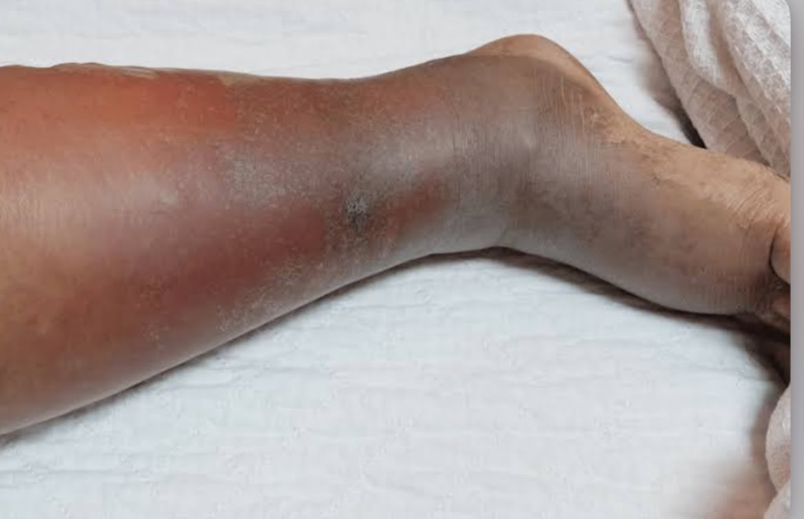
Clinical presentation
Unilateral
Hyperemic area of skin that tends to expand
Tenderness
Warmth
swelling

Slide 7
Systemic Manifestations
Approximately 2–8% of hospitalized cellulitis patients develop bacteraemia-through direct microbial dissemination
Systemic Manifestations
Fever
Malaise
Lymphangitis
Sepsis
Septic shock
Notes:
More common in Erysipelas

Slide 8
Management
Diagnosis
based on clinical manifestations
Leukocytosis, Elevated CRP
Culture of debrided material and blood cultures
  Severe local infection
  Systemic signs of infection
  Extremes of ages
  Presence of underlying comorbidies-

Slide 9
Management
The edge of involved area should be marked- monitor progression
Elevate the affected limb
Identify and Treat portals of entry
Mild Disease (Typical cellulitis no systemic signs of infection)
For 5 days (extend if slow response):
  Cephalexin
  Flucloxacillin
  Dicloxacillin
  If penicillin allergy:
  Clindamycin
Notes:
Non-Purulent Cellulitis- β-hemolytic streptococci (commonly)

Slide 10
Management
Moderate Disease (cellulitis with systemic signs)
Intravenous therapy:
  Cefazolin
  Flucloxacillin IV
Severe Disease(Septic shock, bullae, skin necrosis, crepitus)
Empiric therapy:
  Vancomycin
If concern for necrotizing infection or polymicrobial disease:
  Vancomycin + Piperacillin-tazobactam
  Alternative: Meropenem

Slide 11
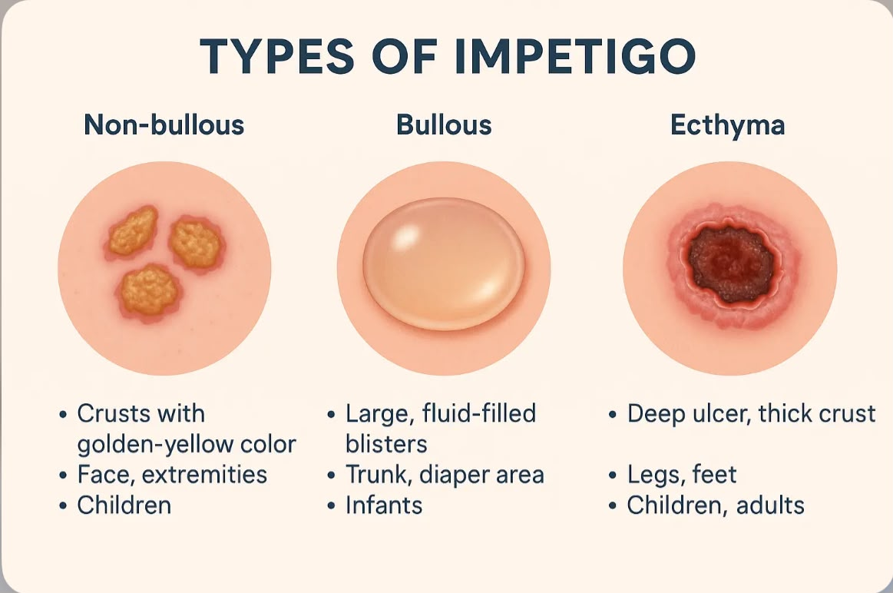
IMPETIGO
Impetigo is a common superficial skin infection, primarily affecting children, and spreads easily through direct contact
- Major clinical forms
Notes:
Nonbullous impetigo – Nonbullous impetigo lesions typically begin as vesicles with surrounding erythema. The erythema may be subtle in patients with darkly pigmented skin. The lesions often coalesce and evolve into pustules that enlarge and rapidly break down to form thick, adherent crusts with a characteristic golden, yellow-brown, or honey color.
In bullous impetigo, vesicles enlarge to form flaccid bullae containing clear yellow fluid, which later become turbid. Ruptured bullae leave an erythematous, shiny, wet base with an overlying thin brown crust or a peripheral rim of scale
Ecthyma – Ecthyma lesions typically present as circumscribed or "punched-out" ulcers with raised, violaceous or hyperpigmented margins and overlying yellow-brown or dark-colored crust

Slide 12
Risk factors
Malnutrition
Immunosuppression
Overcrowding
Diabetes mellitus
Inadequate sanitation practices
Underlying scabies
Vulnerability in infants and young children

Slide 13
EPIDEMIOLOGY
Global median childhood prevalences- 12.3%
It can occur as
Primary Impetigo: This form arises when bacteria invade healthy, unbroken skin.
Secondary Impetigo: Develops as a bacterial infection on skin that has been damaged or injured
Etiology
  Staphylococcus aureus- MRSA VS MSSA
  Group A beta hemolytic streptococci

Slide 14
Pathophysiology
Bullous impetigo arises from Staphylococcus bacteria that secrete exfoliative toxins containing serine proteases
These enzymes target desmoglein, a key protein responsible for binding epidermal cells together
This disruption enables Staphylococcus aureus to infiltrate beneath the stratum corneum, creating a toxin-induced space that causes the epidermis to split just below the stratum granulosum layer.
As a result, large blisters filled with neutrophils develop within the epidermis- rupture rapidly, leading to superficial skin erosions covered by a characteristic yellow crust

Slide 15
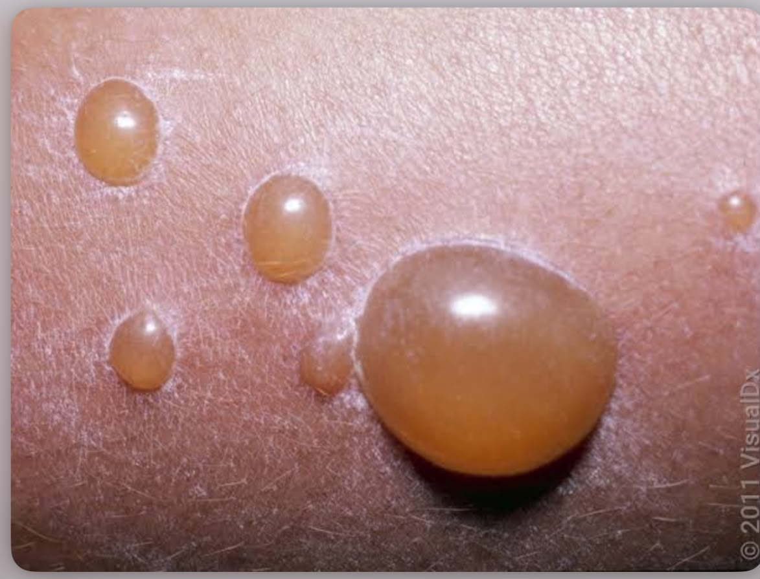
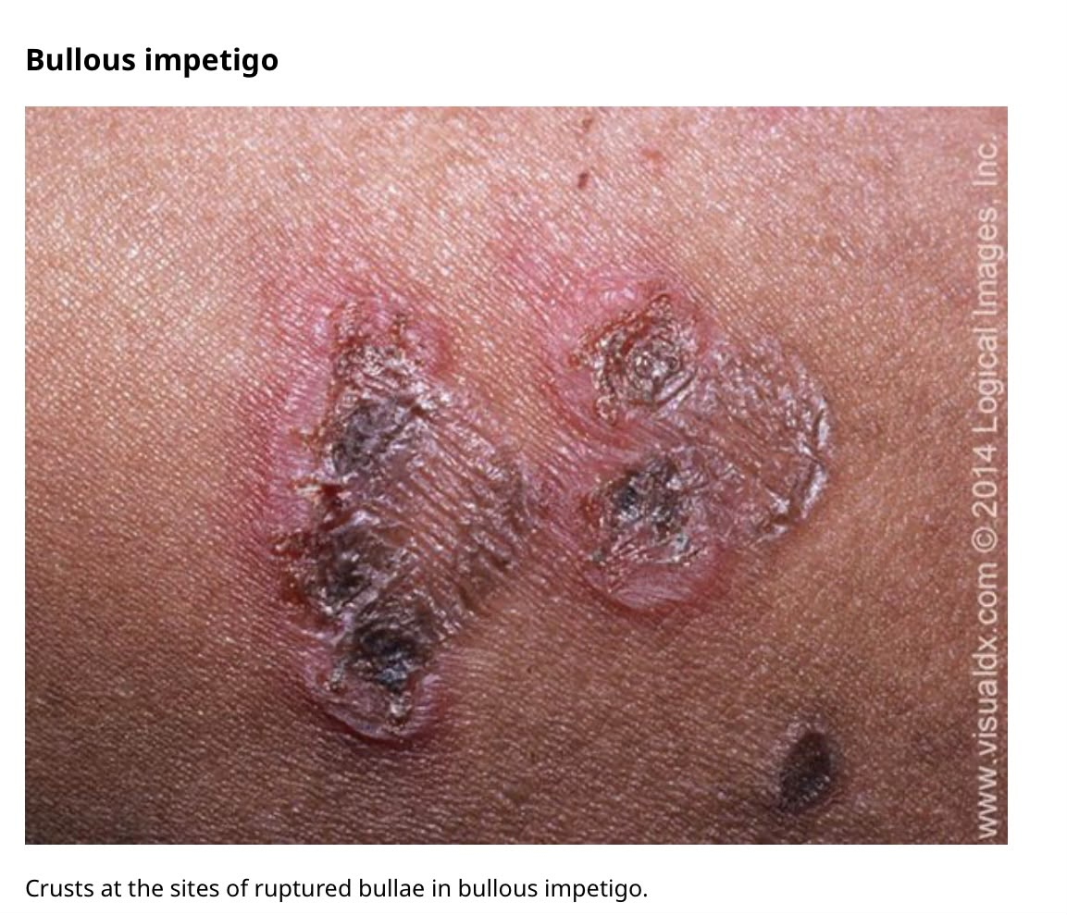

Slide 16
Cont…..
Non-bullous impetigo, typically caused by Streptococcus species, presents with thick-walled pustules resting on a red, inflamed base.
The lesions often coalesce and evolve into pustules that enlarge and rapidly break down to form thick, adherent crusts with a characteristic golden, yellow-brown, or honey color
Histological examination of established non-bullous lesions reveals a dense surface crust composed of serum, neutrophils at various stages of degradation, and parakeratotic material.

Slide 17
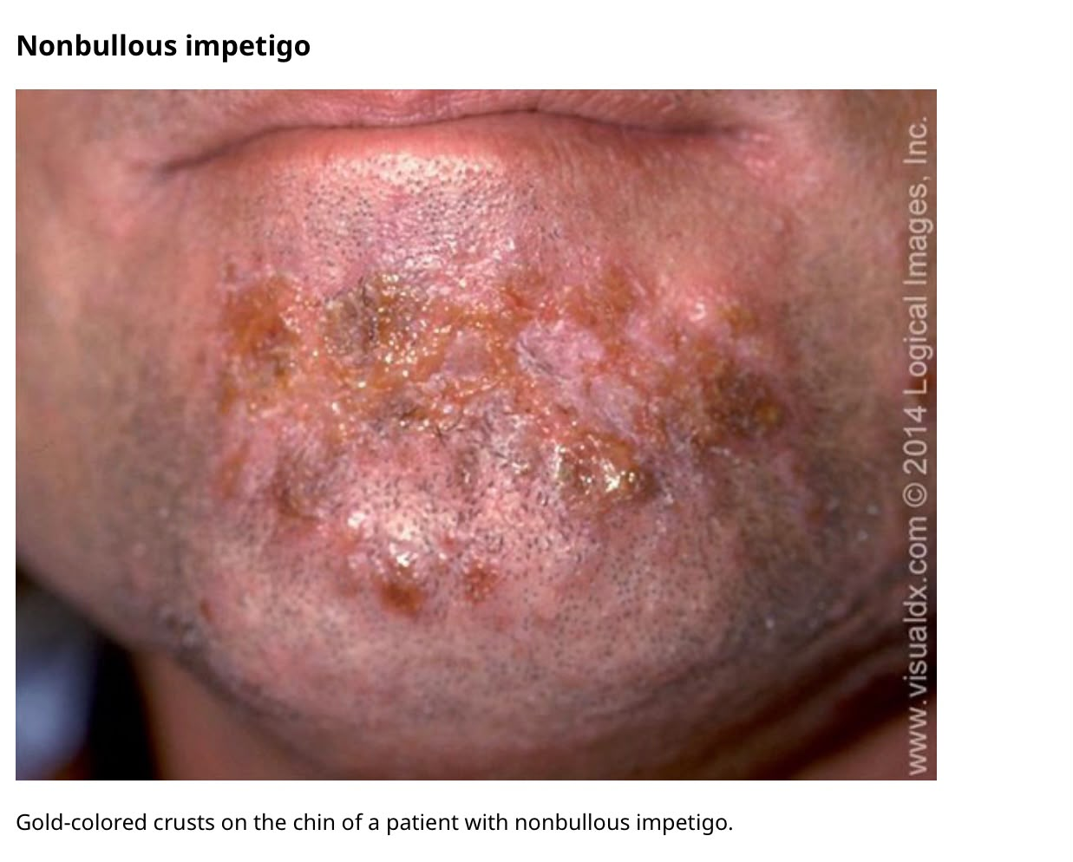
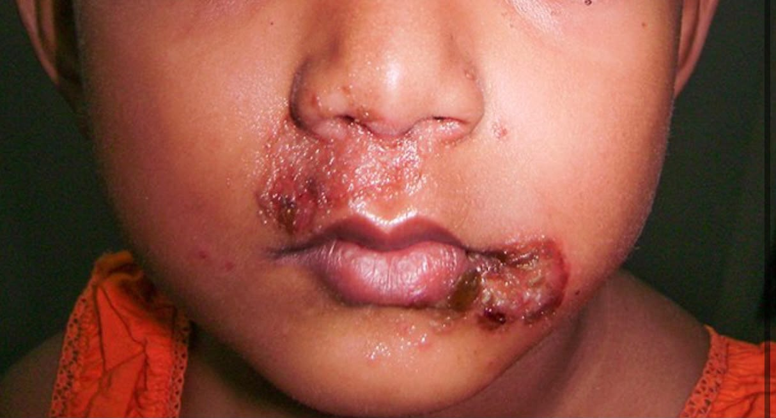

Slide 18
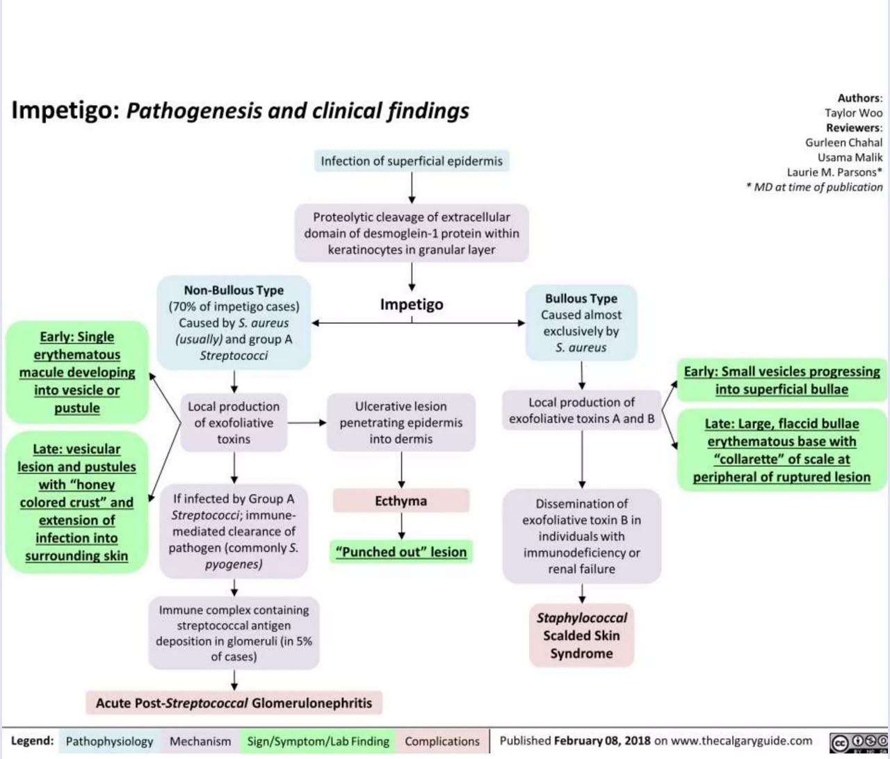

Slide 19
COMPLICATIONS
Staphylococcal scalded skin syndrome
Arises from a focus of infection with an exfoliative toxin-producing S. aureus strain, such as impetigo
Initial signs of staphylococcal scalded skin syndrome include skin erythema, exfoliation, and skin pain, particularly in skin folds
Subsequently, erythema becomes generalized, and flaccid bullae and erosions appear. Extensive crusting and fissuring may occur on the face.

Slide 20
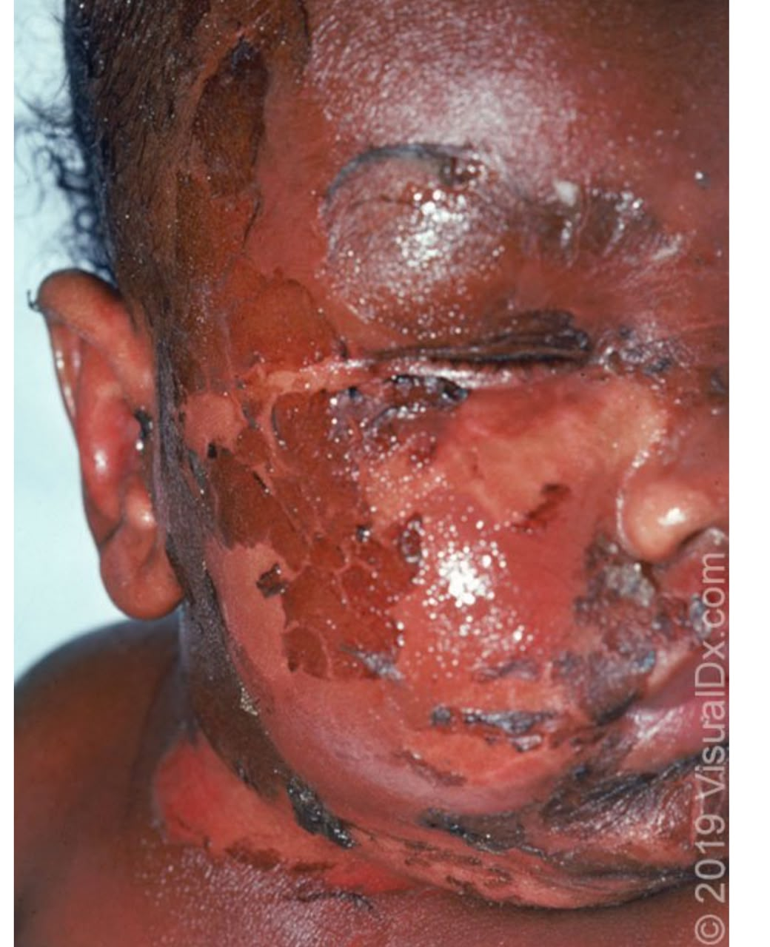

Slide 21
SYSTEMIC MANIFESTATIONS
Poststreptococcal glomerulonephritis
Is a potential complication of infection with nephritogenic strains of group A beta-hemolytic Streptococcus.
It usually occurs within 2- 6 weeks after skin infection.
Antigen- Antibody complexes deposits in Glomerular basement membrane
Common clinical findings include edema, hypertension, fever, and hematuria. Acute kidney injury can occur
Notes:
Type 3 hypersensitivity rxn,
Occures 1-3 weeks after pharyngitis

Slide 22
Cont…..
Acute rheumatic fever –is an autoimmune disorder that can occur following group A streptococcal pharyngitis (predominantly) or impetigo
The disease primarily occurs in children
Antibodies against M protein cross react with host tissues (cardiac myosin)
Clinical features include arthritis, carditis, chorea, erythema marginatum and subcutaneous nodules
Acute rheumatic fever may lead to cardiac valve damage and subsequent complications of rheumatic heart disease.

Slide 23
Cont….
Toxic Shock Syndrome (TSS)
is an acute, life-threatening illness caused by bacterial exotoxins acting as superantigens, leading to massive cytokine release, shock, and multiorgan dysfunction
Often associated with necrotizing fasciitis, cellulitis, or invasive soft tissue infection((Group A Streptococcus)
Notes:
Staphylococcal TSS
Caused by Staphylococcus aureus
Toxin: TSST-1 (Toxic Shock Syndrome Toxin-1) and enterotoxins

Slide 24
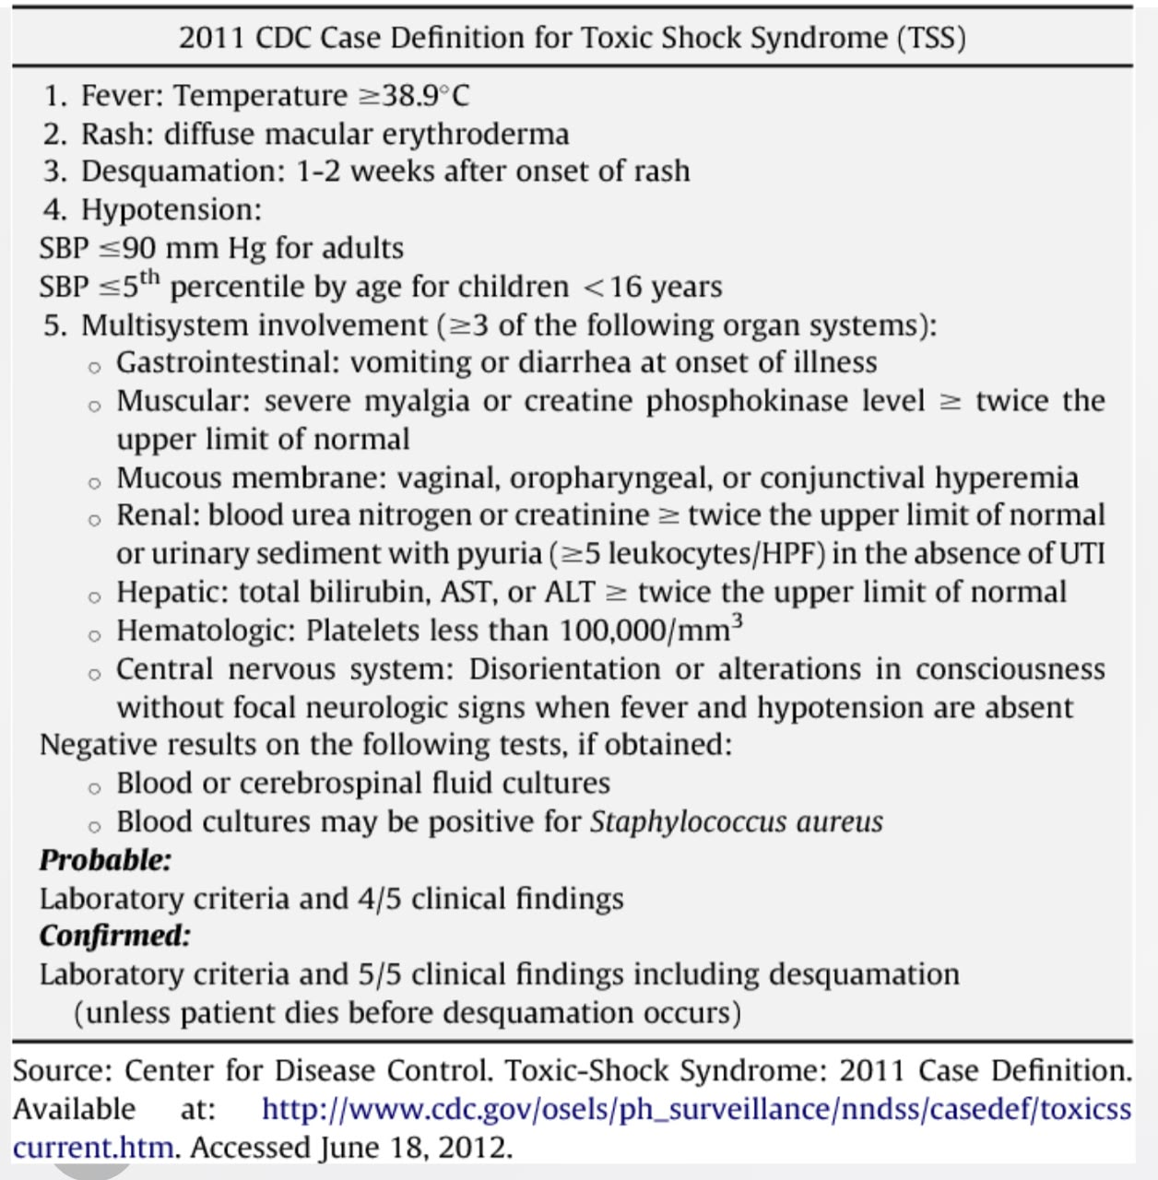
Diagnostic criteria -TSS

Slide 25
Management
Localized Impetigo (Fewer than 10 lesions and <36 cm² of involved skin area)
First-line: Topical antibiotics for 5 days
  Mupirocin 2% ointment three times daily
  Retapamulin 1% ointment twice daily
  Ozenoxacin (where available)
Extensive Disease
Oral antibiotics for 7 days
Preferred oral agents(Staphylococcus aureus or Streptococcus pyogenes)
  Flucloxacillin
  Dicloxacillin 500mg q6hrly
  Cephalexin 500mg qhrly
If penicillin allergy
  Clindamycin 450 q8h
Notes:
Before applying:
Gently wash lesions with soap and water
Remove crusts with warm compresses.
Phenoxymethylpenicillin 500mg 6hrly
Erythromycin 500mg
Amoxiclav

Slide 26
Leprosy

Slide 27
Introduction
Definition: A chronic, infectious disease caused by the slow-growing bacterium Mycobacterium leprae.
Primary Targets: Mainly affects the skin, peripheral nerves, mucosal surfaces of the upper respiratory tract, and the eyes.
Transmission: Spread via droplets from the nose and mouth during close and frequent contact with untreated cases.
Spectrum of Disease: Manifests differently based on the host's immune response, ranging from localized (Tuberculoid) to generalized (Lepromatous).

Slide 28
Cardinal Sign: Skin lesions that present with a characteristic loss of sensation (hypoesthesia/anesthesia).
Common Presentations:
  Macules or Plaques: Flat or raised skin lesions that may be hypopigmented (lighter than surrounding skin) or erythematous (reddish).
  Dryness & Alopecia: Affected skin areas often lose hair and ability to sweat due to local nerve damage.
Spectrum Variations:
  Tuberculoid (Paucibacillary): Few, well-defined, anesthetic lesions.
  Lepromatous (Multibacillary): Multiple, widespread, symmetric nodules or plaques; can lead to facial skin thickening ("leonine facies") in advanced stages.

Slide 29
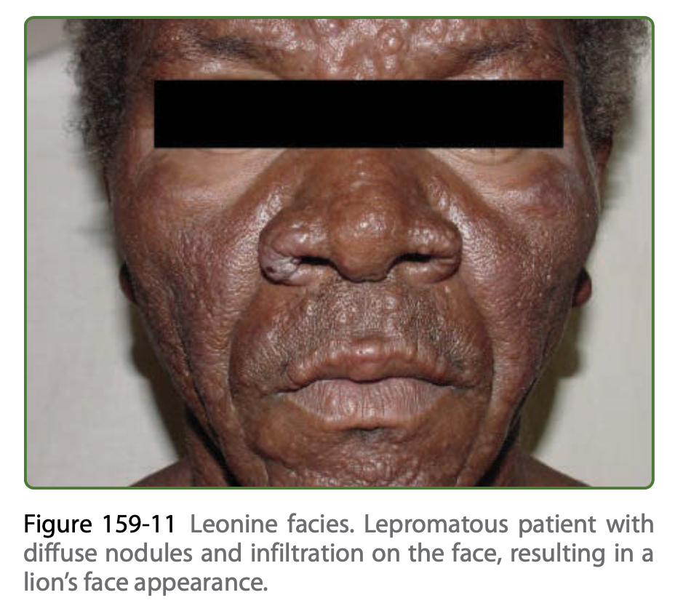
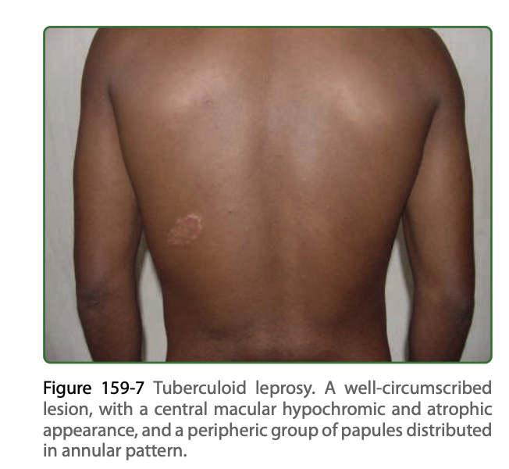

Slide 30
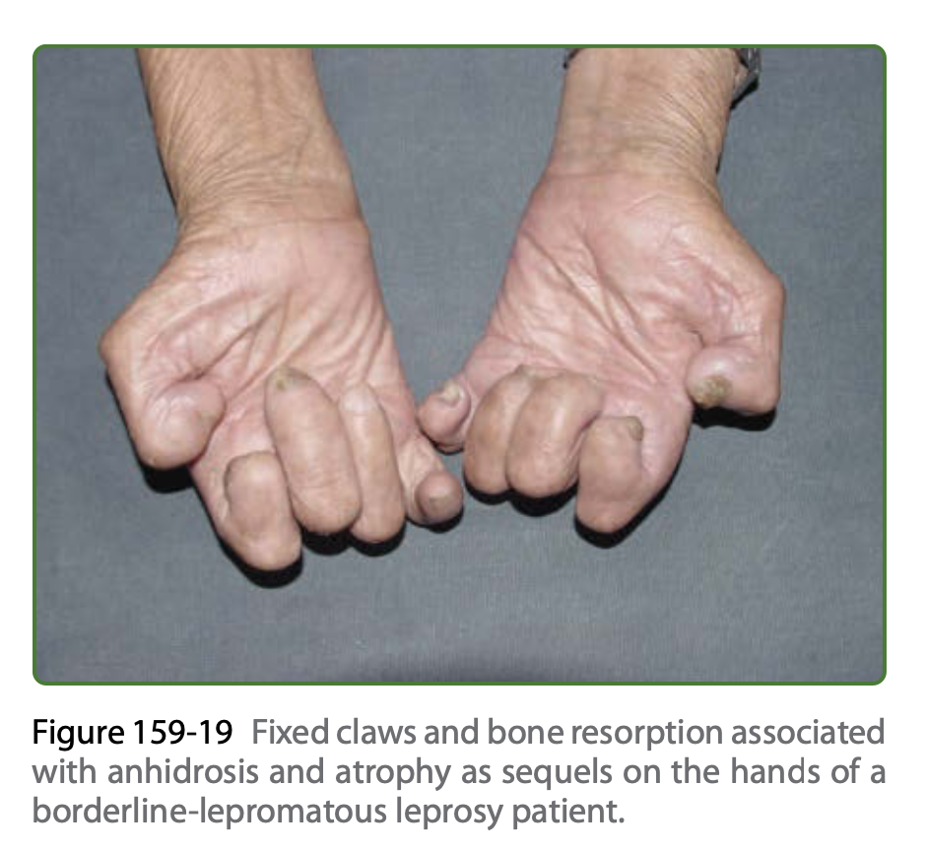

Slide 31
Systemic manifestations

Slide 32
Peripheral Nerve Damage & Physical Signs
First Target of Infection: M. leprae attacks peripheral nerves early, often before skin lesions appear.
Nerve Inflammation: Immune cell infiltration causes swelling and inflammation.
Palpation Findings: Highly trained professionals look for key physical changes:
  Thickening: Notable enlargement of nerve trunks.
  Tenderness: Physical pain or soreness during examination.
  Fibrosis: Nerves lose their soft, normal texture and become stiff/fibrotic.

Slide 33
Functional Loss & Facial Complications
Three Key Functional Deficits:
  Sensory: Hypoesthesia or total loss of sensation (anesthesia) in the nerve's territory.
  Motor: Muscle weakness and wasting (e.g., interosseous muscle hypotrophy).
  Autonomic: Deficit in skin sweating.
    Facial & Trigeminal Nerve Damage:
    Loss of facial sensation, including corneal anesthesia.
    Lagophthalmos: Inability to close the eyelids due to palpebral muscle wasting.
    Primary Neural Leprosy: Up to 17% of patients present with nerve deficits and zero skin lesions.

Slide 34
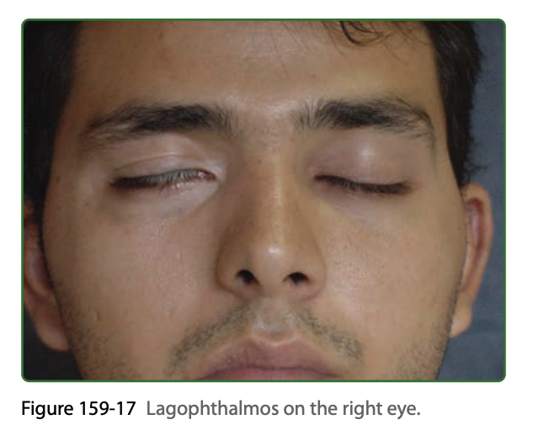

Slide 35
Endocrine & Hormonal Manifestations
High Prevalence: Affects up to 25% of patients, representing the third most prominent feature after nerve/skin lesions.
Systemic Complications:
  Hypothyroidism & Euthyroid sick syndrome
  Osteoporosis
Reproductive Impacts: Hypogonadism and sterility.
Neuro-Immune-Endocrine Link: Pro-inflammatory cytokines (IL-6, TNF-alpha) drive hormonal imbalances:
  Testosterone and DHEAS levels drop.
  Gonadotropins (LH, FSH) increase.

Slide 36
Investigations
Electrophysiology (Nerve & Muscle Function)
  Nerve Conduction Studies (NCS)
  Electromyography (EMG)
Peripheral Nerve Biopsy: The gold standard for confirming primary neural leprosy.
Hormonal Panels

Slide 37
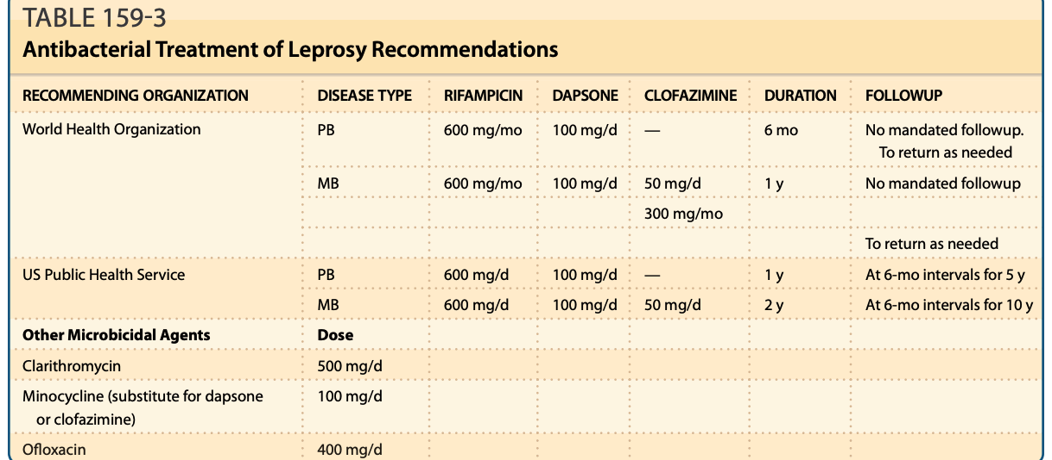
Treatment

Slide 38
Adjuvants
Systemic corticosteroids
  acute nerve inflammation (neuritis)
TCA or anti convulsants
  Chronic neuritis

Slide 39
Syphilis

Slide 40
Introduction
Primary Stage (Chancre): A single, painless, indurated ulcer at the site of inoculation (genital, perianal, or oral) that resolves spontaneously in 3 to 6 weeks.
Secondary Stage (Generalized Rash): A widespread, symmetric maculopapular eruption that characteristically involves the palms and soles, typically non-pruritic.
Mucocutaneous Features (Secondary):
  Condyloma Lata: Highly infectious, moist, flat, gray-white papules in intertriginous or mucosal areas.
  Mucous Patches: Shallow, painless erosions on oral or genital mucous membranes.
  Alopecia: Patchy, "moth-eaten" hair loss of the scalp, eyebrows, or beard.
Tertiary Stage (Gummas): Chronic, destructive granulomatous lesions that manifest as deeply ulcerated, necrotizing plaques on the skin and subcutaneous tissues.

Slide 41
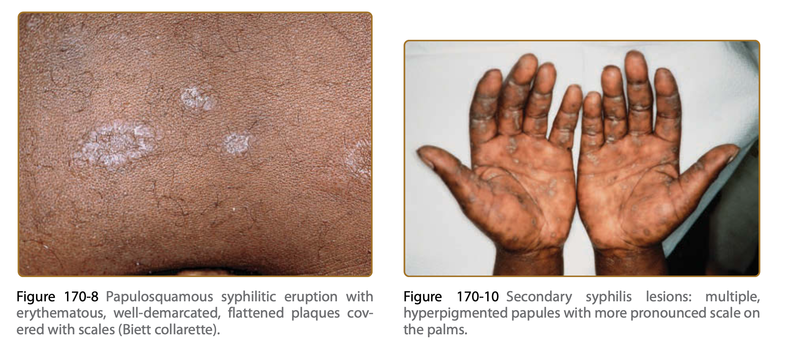

Slide 42
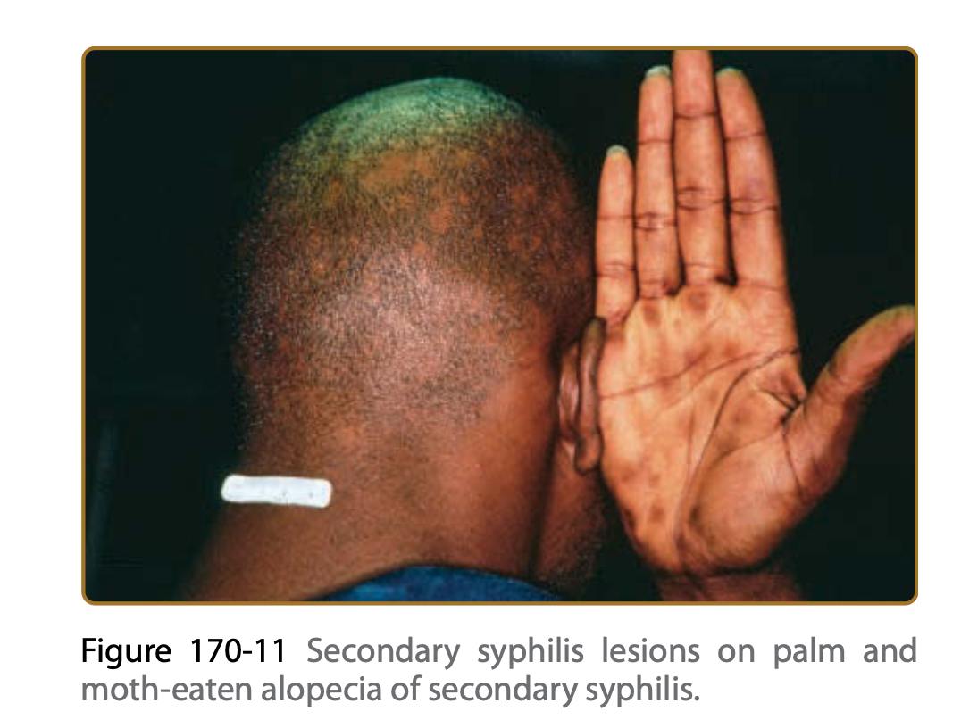

Slide 43
Systemic Manifestations

Slide 44
Systemic & Organ Involvement
Constitutional Symptoms: Fever, malaise, sore throat, headache, weight loss, hoarseness, and musculoskeletal aches.
Lymphadenopathy: Common, bilateral, and symmetric lymph node swelling.
Organ Inflammation: Gastritis, hepatitis, periostitis (bone lining), and membranous glomerulopathy (kidney disease).
Hematologic: Anemia, lymphopenia, and elevated ESR.

Slide 45
Neurosyphilis (Early vs. Late)
Asymptomatic: No physical symptoms; defined strictly by abnormal CSF.
Early Symptomatic:
  Meningitis: Fever, meningismus, and headache.
  Meningovasculitis: Stroke, typically affecting the middle cerebral artery.
  Cranial Nerve Palsies: Most commonly affects CN II, III, IV, VI, VII, and VIII.
Late Tertiary (Rare):
  General Paresis: Rapidly progressive dementia and personality changes.
  Tabes Dorsalis: Spinal cord posterior column damage causing sensory ataxia and bowel/bladder dysfunction.

Slide 46
Ocular & Otologic Manifestations
Otologic Syphilis: Sensorineural hearing loss is the primary manifestation.
Ocular Syphilis (Any Stage):
  Uveitis: Most common ophthalmic sign (pain, redness, photophobia).
  Optic Nerve Damage: Papillitis, retrobulbar neuritis, and optic atrophy.
  Pupillary/Visual Defects: Argyll Robertson pupil (accommodates but doesn't react to light) and bitemporal hemianopia via chiasmal syndrome.
  Structural Issues: Retinal detachment, cataracts, glaucoma, and interstitial keratitis.

Slide 47
Latent & Tertiary Syphilis
Latent Phase: Complete absence of clinical findings; infection is detectable only via positive serologic tests.
Late Tertiary Manifestations: Develops 15–40 years after untreated infection.
  Cardiovascular Syphilis: Direct damage to the cardiovascular system.
  Internal Gummas: Granulomatous, erosive lesions destructive to the bones and internal organs.

Slide 48
Investigations
Serologic Screening: Requires a two-step confirmation process:
  Nontreponemal tests (RPR or VDRL): Quantify antibody titers; track disease activity and treatment response.
  Treponemal tests (FTA-ABS, EIA, CIA, TP-PA): Confirm positive screens; typically remain positive for life.
Lumbar Puncture & CSF Examination: Required if neurological, ocular, or otologic symptoms are present. Evaluates CSF cell count, protein levels, and CSF-VDRL.
Direct Detection: PCR, darkfield microscopy, or lesion biopsy for primary ulcers.

Slide 49
Treatment
Early Syphilis (Primary, Secondary, Early Latent):
  Preferred: Benzathine Penicillin G (BPG) 2.4 million units IM as a single dose.
  Alternative (Penicillin-Allergic): Doxycycline 100 mg orally twice daily for 14 days.
Late Latent or Tertiary (Gummatous/Cardiovascular) Syphilis:
  Preferred: Benzathine Penicillin G (BPG) 7.2 million units total (3 weekly doses of 2.4 million units IM).
  Alternative (Penicillin-Allergic): Doxycycline 100 mg orally twice daily for 28 days.

Slide 50
Targeted Neurosyphilis therapy
Applies to: Confirmed neurosyphilis, ocular syphilis, and otosyphilis.
Preferred Intravenous Therapy:
  Aqueous Crystalline Penicillin G: 18–24 million units daily.
  Administration: Given as 3–4 million units IV every 4 hours or via continuous infusion for 10–14 days.
Alternative Therapy:
  Procaine Penicillin G 2.4 million units IM once daily PLUS Probenecid 500 mg orally 4 times daily, both for 10–14 days.
Note: Penicillin-allergic patients with neurosyphilis must ideally undergo desensitization.

Slide 51
Herpes Zoster

Slide 52
Introduction
Typical Presentation
  Unilateral Dermatomal Rash: Grouped painful fluid-filled blisters that follow a single nerve pathway and do not cross the midline.
  Progression: Evolves from red papules → vesicles → pustules → crusts over 7 to 10 days.
Cutaneous Complications
  Secondary Bacterial Infection: Usually Staph or Strept species; delays healing and causes permanent scarring.
  Superficial Gangrene: Severe tissue necrosis and scarring, typically seen in immunocompromised patients.
  Disseminated Zoster: Widespread, chickenpox-like rash (25–50 lesions) outside the primary area; signals a high risk for internal organ spread.
  Chronic Atypical Lesions: Persistent, wart-like or ulcerated lesions seen in advanced HIV/AIDS, often due to drug-resistant virus strains.

Slide 53
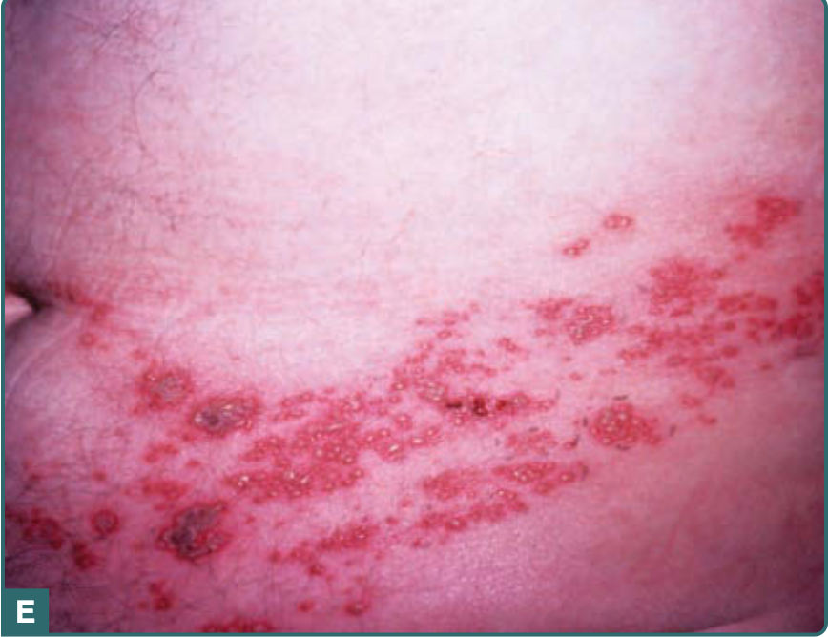

Slide 54
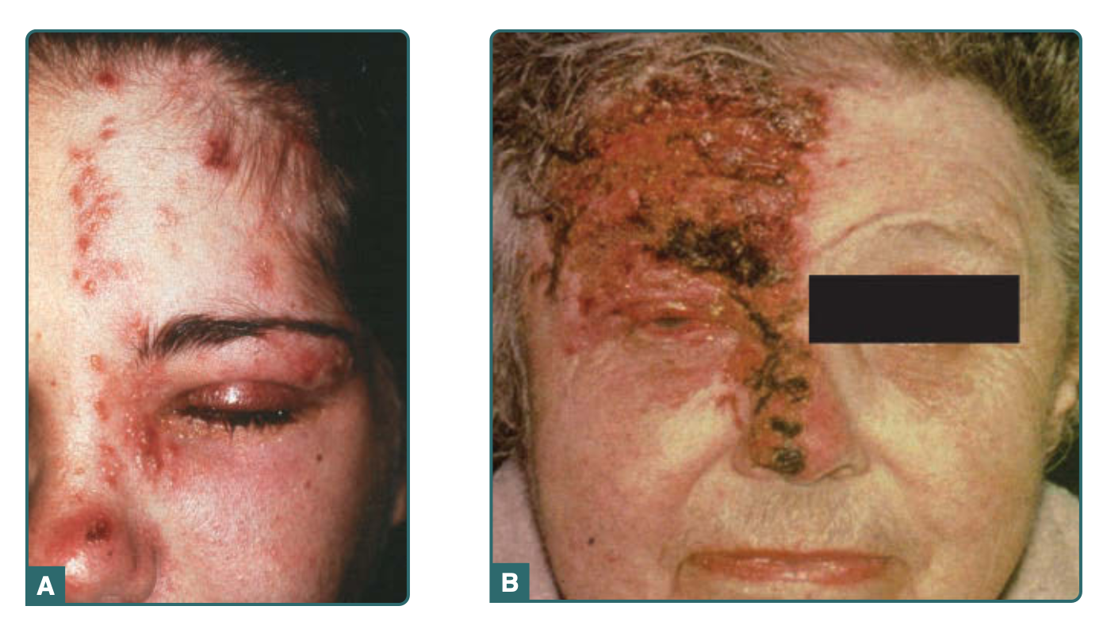

Slide 55
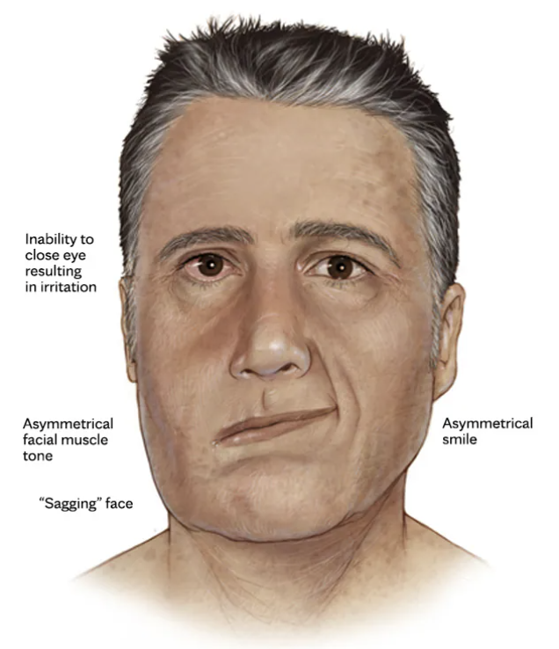
Ramsay Hunt syndrome

Slide 56
Systemic manifestations

Slide 57
Neurologic Manifestations
Postherpetic Neuralgia (PHN): The most common complication, defined as pain persisting 1 to 6+ months after rash onset. Characterized by constant (burning, aching), intermittent (stabbing, shooting), or stimulus-evoked pain.
Allodynia: Severe pain triggered by normally non-painful stimuli (like a light breeze or clothing contact), affecting approximately 90% of PHN patients.
Delayed Contralateral Hemiplegia (Stroke): Caused by VZV infecting cerebral arteries and causing segmental granulomatous angiitis. This leads to a contralateral stroke occurring weeks to months (average 7–8 weeks) after ophthalmic herpes zoster.
Other Neurologic Extension: Spread of the virus can directly involve the spinal cord.

Slide 58
Post Herpetic neuropathy
Issues: Long-term nerve pain lasting months to years after the rash heals.
Investigations: Clinical diagnosis based on the timing and nature of the pain.
Treatment:
  Nerve Pain Medications: Gabapentin, Pregabalin, or Amitriptyline.
  Topical Relief: Lidocaine patches or Capsaicin cream (only on fully healed skin).

Slide 59
VZV CNS Vasculopathy (Stroke Risk)
Issue: Virus infects brain arteries, causing inflammation and delayed stroke (weeks/months later).
Investigations:
  Lumbar Puncture: CSF analysis for VZV antibodies.
  Brain Imaging: MRI/CT scan and Angiography (MRA/CTA) to see narrowed blood vessels.
Treatment: Emergency hospital admission for IV Acyclovir combined with systemic steroids to lower inflammation.

Slide 60
Visceral & Mucosal Manifestations
Widespread Visceral Dissemination: Viral spread via the bloodstream or nerves to internal organs, particularly the lungs, liver, and brain; this is often fatal and occurs primarily in immunocompromised patients.
Dermatome-Corresponding Visceral Lesions:
  Gastric mucosa lesions (associated with thoracic herpes zoster).
  Hemicystitis (associated with sacral herpes zoster).
  Mucosal lesions causing esophagitis, pleuritis, and peritonitis.
Motility and Sphincter Dysfunction: Infection of visceral afferents in mechanoreceptors can lead to ileus, symptoms of gastrointestinal obstruction, and bladder/anus dysfunction.
Myositis: Caused by the transmission of ganglionic infection via proprioceptive afferents.

Slide 61
Organ Involvement (Lungs, Liver, Gut)
Issue: High-mortality spread to organs (Pneumonitis, Hepatitis, Gastritis, or Intestinal Ileus); common in immunocompromised patients.
Investigations:
  PCR Testing: Rapid blood or tissue fluid DNA testing to confirm VZV.
  Imaging: Chest CT (for lung involvement) or abdominal scans.
Treatment:
  Immediate Action: Emergency hospitalization; do not wait for lab confirmation to start treatment.
  Medication: High-dose IV Acyclovir.
  Alternative: IV Foscarnet if the virus strain is resistant to Acyclovir.

Slide 62
Ocular Manifestations (Ophthalmic Zoster)
Impaired Corneal Sensation: Severe impairment can progress to neurotrophic keratitis.
Chronic Ocular Complications: Can result in chronic corneal ulceration and secondary bacterial infections.

Slide 63
Herpes Zoster Ophthalmicus (HZO)
Issue: Threatens eyesight; causes corneal scarring, chronic inflammation, or retinal death.
Investigations:
  Slit-Lamp Exam: Check for corneal ulcers and internal eye inflammation.
  Eye Pressure Test: Monitor for secondary glaucoma.
Treatment:
  Immediate Oral Antivirals: High-dose Valacyclovir or Famciclovir.
  Targeted Eye Drops: Topical steroid drops (under strict specialist supervision) and dilating drops.

Slide 64
Systemic Impact on Quality of Life (Secondary to PHN)
Constitutional & Psychological Symptoms: Chronic pain frequently causes disordered sleep, depression, anorexia, weight loss, chronic fatigue, and social isolation.
Functional Impairment: Interferes with basic daily activities such as bathing, dressing, traveling, shopping, cooking, and housework.

Slide 65
Vascular Associations (Controversial)
Reactivation of latent VZV and resulting granulomatous angiitis has been associated in some studies with temporal arteritis, myocardial infarction, and aortic aneurysms, though these links remain controversial.

Slide 66
References
Fitzpatrick's Dermatology, 9th Edition (published by McGraw-Hill Education).
Workowski, K. A., Bachmann, L. H., Chan, P. A., et al. (2021). Sexually Transmitted Infections Treatment Guidelines, 2021. MMWR Recommendations and Reports, 70(4), 1–187.
Tsuboi, M., Evans, J., Davies, E. P., et al. (2024). Syphilis. The Lancet, 403(10432), 1184–1202.
Kojima, N., & Klausner, J. D. (2024). Syphilis: A Review. JAMA, 331(4), 329–341.
Panel on Guidelines for the Prevention and Treatment of Opportunistic Infections in Adults and Adolescents with HIV. (2025).
Uptodate

